Slide 1

CSC 533: Privacy in the Digital Age (Fall 2020) Lecture 21: Factors Influencing Privacy Behavior
Anupam Das
Oct. 29, 2020

Slide 2
Goals for today
Difference in privacy behavior and attitude among people from different culture/background
Difference in attitude among developers vs. general users
Factors influencing adoption of IoT devices
Some slide contents taken from Dr. Özgür Kafalı

Slide 3
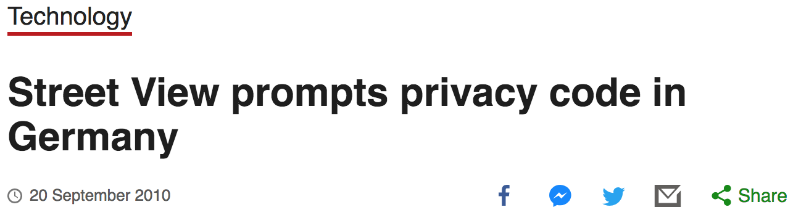
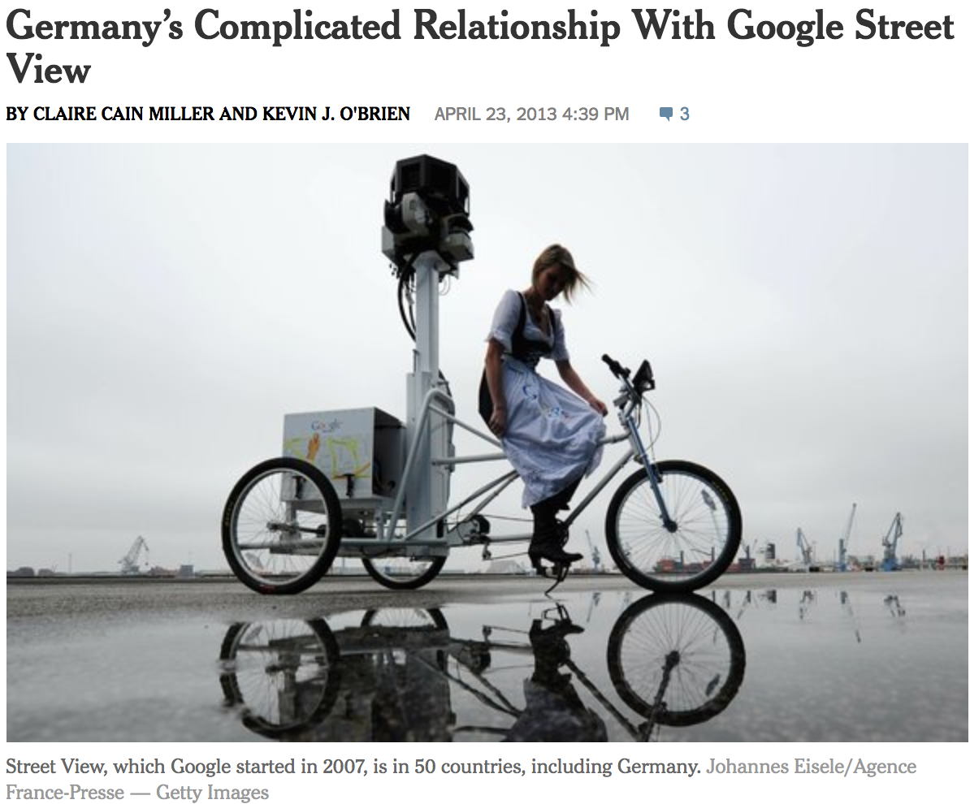
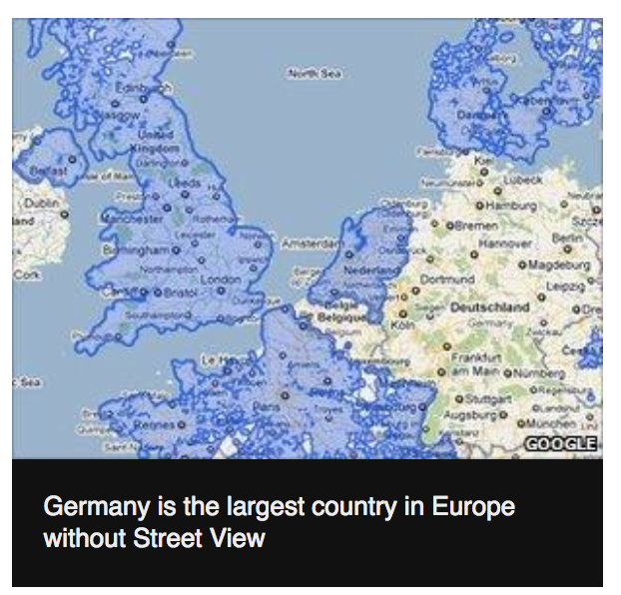
Why are cultural differences in privacy important?

Slide 4
Studies that we’ll look at today
Privacy attitudes among different countries and cultures
America, Europe, Asia
mTurk workers vs. the public
Factors for adopting IoT devices

Slide 5
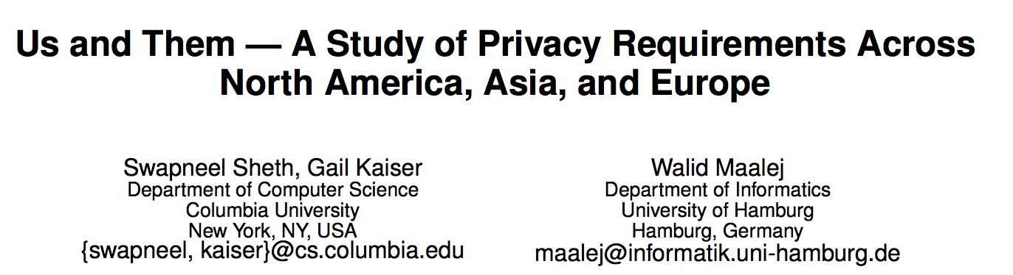
Us and Them
Objective: Understand the privacy expectations and needs for modern software systems.
Research questions:
What are developers’ and users’ perceptions of privacy?
Does experience in software development have any impact on privacy requirements?
Does geography have any impact on privacy requirements?
Sheth et al. Us and Them: A Study of Privacy Requirements Across North America, Asia, and Europe. International Conference on Software Engineering (ICSE), pages 859–870, 2014

Slide 6
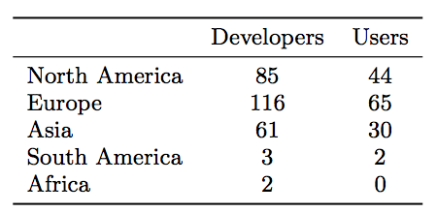
Method: Survey
Survey
Recruit from different countries
Two language: English and German
Slightly different survey for participants with development experience
267 have software development experience and 141 do not

Slide 7
Factors that increase privacy concerns
Asked questions about the factors that may increase privacy concerns
Data Aggregation: The system discovers additional information about the user by aggregating data over a long period of time
Data Distortion: The system might misrepresent the data or user intent
Data Sharing: The collected data might be given to third parties for purposes like advertising
Data Breaches: Malicious users might get access to sensitive data about other users

Slide 8
Factors that reduce privacy concerns
Asked questions about the factors that may reduce privacy concerns
Privacy Policy, License Agreements: Describing what the system will/won’t do with the data
Privacy Laws: Describing which national law the system is compliant with (e.g., HIPAA in the US, European privacy laws)
Anonymizing all data: Ensuring that none of the data has any personal identifiers
Technical Details: Describing the algorithms/source code of the system in order to achieve higher trust (e.g., encryption of data)
Details on usage: Describe, e.g., in a table how different data are used

Slide 9
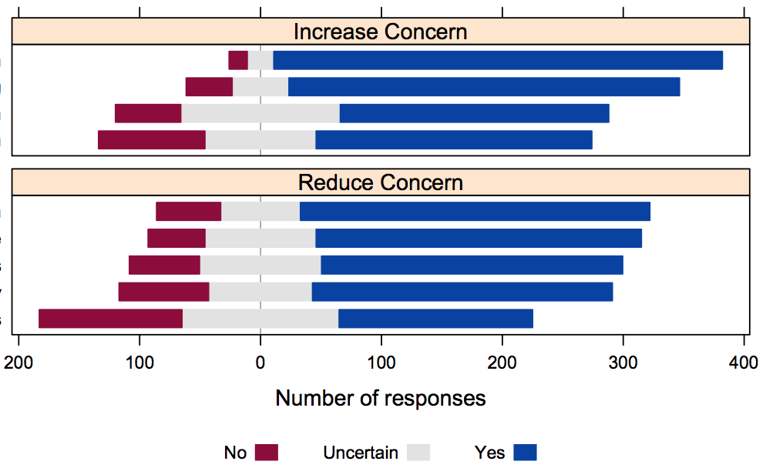
What do you think?
Increase concern: Aggregation, Distortion, Sharing, Breaches
Reduce concern : Policy, Laws, Anonymization, Technical details, Usage

Slide 10
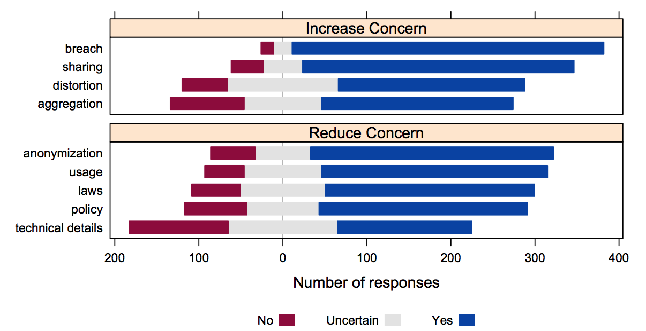
Factors to Increase and Reduce Concerns
People are more concerned about data sharing and data breaches than data distortion and data aggregation.
Different people assess the importance of various privacy mitigation measures differently

Slide 11
Exercise: Additional Concerns
66 comments [15 comments were useless as they just repeated the standard response options]
Authorities and intelligence services: Government access [13/66]
Malicious software or sharing data over APIs: Google Analytics [9/66]
Unusable and nontransparent policies: Long, convoluted, hard to read [7/66]
Lack of control: Options to delete data [7/66]

Slide 12
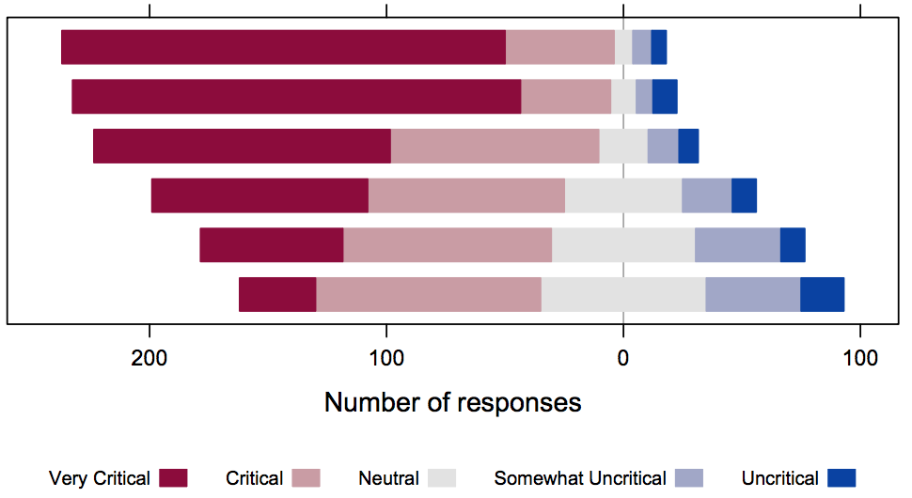
What types of data are critical?
Options: Content (email body), metadata (date), interaction (mouse click to open email), location (the city, email is sent from), personal data (email address, name, address), user preferences (email settings)

Slide 13
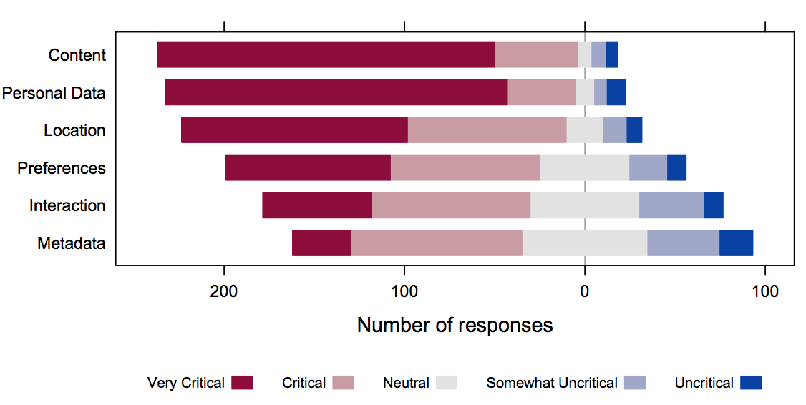
Criticality of Types of Data
Options: Content (email body), metadata (date), interaction (mouse click to open email), location (the city, email is sent from), personal data (email address, name, address), user preferences (email settings)

Slide 14
Giving up privacy
Would you accept less privacy for the following:
Monetary discounts (e.g., 10% discount on the next purchase)
Added functionality of the system (such as Amazon recommendations)
Fewer ads
“Yes,” “Uncertain,” and “No.”
37% accepts less privacy for added functionality
21% accepts less privacy for monetary discounts
14% accepts less privacy for fewer ads

Slide 15
Developers vs. Users
Factor that increase privacy concerns:
Data distortion: 49% of developers vs. 65% of users
Data aggregation: 52% of developers vs. 63% of users
Data criticality: Name, personal data, and interaction are more critical for developers
Added functionality: 43% of developers give up privacy (vs. 31%)

Slide 16
Role of Geography
What about American vs. European and Asian?
American thinks all types of data are less critical than European
What about European vs. Asian?
No statistically significant difference between Europe and Asia
Who would give up privacy more for added functionality?
Added functionality: 51% of European would not give up privacy, only 24% American would give up privacy
Who are more hopeful of laws and policies?
European feels that providing usage details is more effective than laws and policies
American feels these options are all equal

Slide 17
Proposed Privacy Framework
Following things should be considered when developing service using sensitive data:
Anonymization
Data usage details
Default encryption
Fine-grained control
Time and space limited storage
Policies and laws

Slide 18
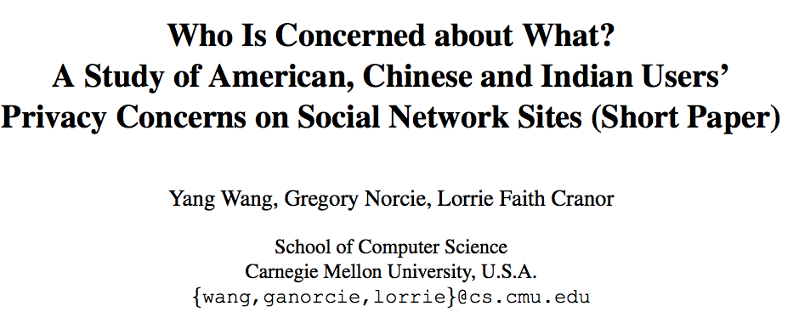
Who is Concerned About What?
Countries: US, China, India
Social network sites:
Facebook: Highest traffic in US and India
Renren.com and Kaixin001.com: Domestic sites for China
Common features: Profiles, walls, photo sharing, games, third party app development
Wang et al. Who is Concerned About What? A Study of American, Chinese and Indian Users’ Privacy Concerns on Social Network Sites. International Conference on Trust and Trustworthy Computing, pages 146–153, 2011

Slide 19
Study design
Study design
Survey: attitudes toward sharing, privacy-related experiences and behavior -- focused on SNS
US, India = MTurk participants, n=321 US; n=312 India
China = ZBJ participants (crowdsourcing site), n=291

Slide 20
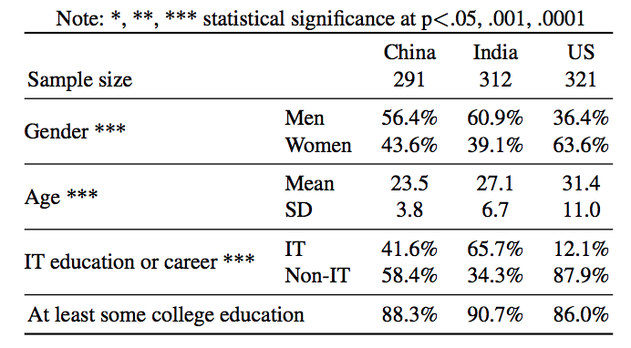
Demographics

Slide 21
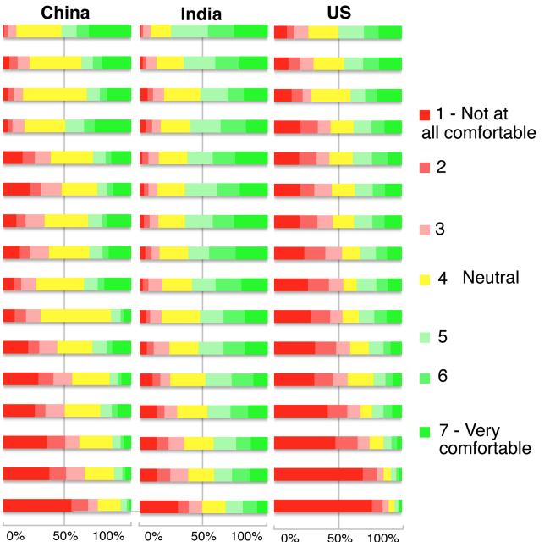
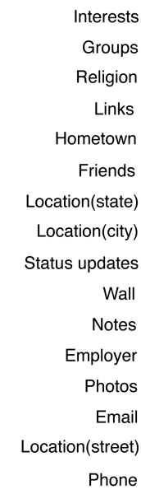
Privacy Attitudes of Personal Content
Increase in concern

Slide 22
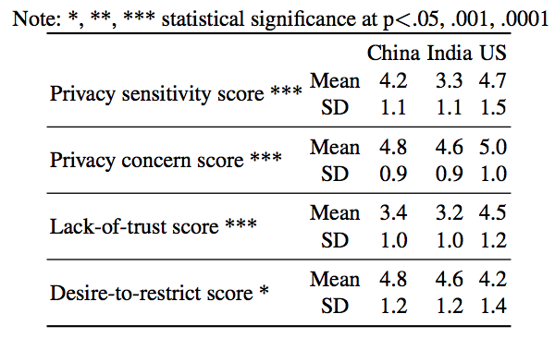
Dimensions of SNS attitude
US>China>India
US>China>India (similar)
US>China>India
China>India>US (similar)

Slide 23
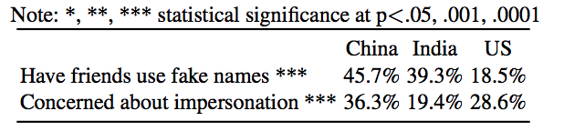
Fake Names and Impersonation
China>India>US
China>US>India

Slide 24
Location sharing in US vs. China
3 week study of location sharing preferences
Sample: n=29 in US, n=30 in China
– Student samples
Location tracking software installed on phones, uploaded every 5 minutes to study servers
– GPS and Wi-Fi positioning
Participants log into site daily and report on willingness to share locations
– Comfort sharing location with [close friends & family, SNS friends, university community, advertisers]
– Preferred granularity of sharing
Lin et al, “A comparative study of location-sharing privacy preferences...”, 2013

Slide 25
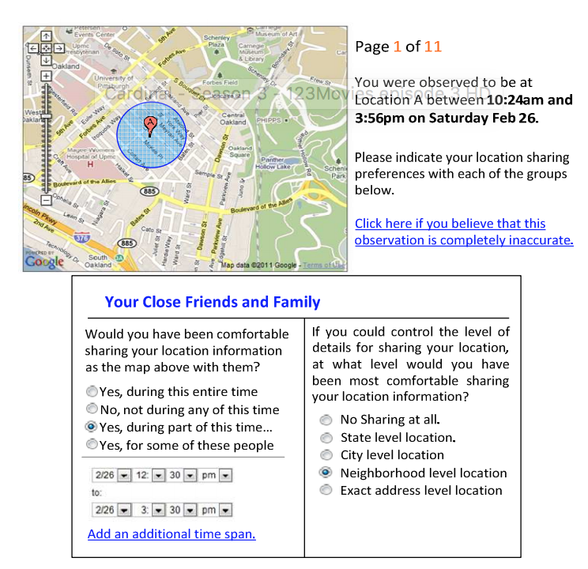
Goals for today
Questions about their willingness to share their location with members of four different groups (Close friends and Family, Friends on SNs, Members of the University Community, Advertisers) were displayed just under the map

Slide 26
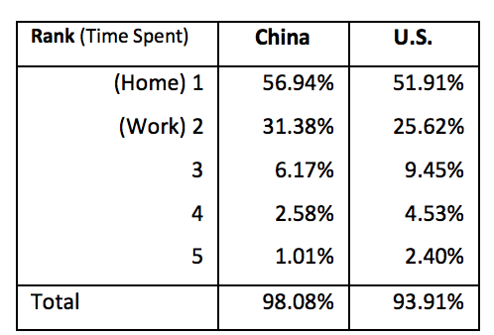
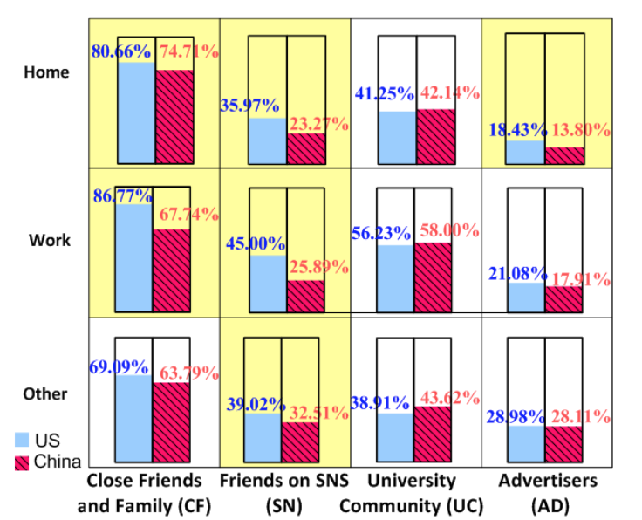
Willingness to share location
Chinese participants on average spent 56.94% of their time at home

Slide 27
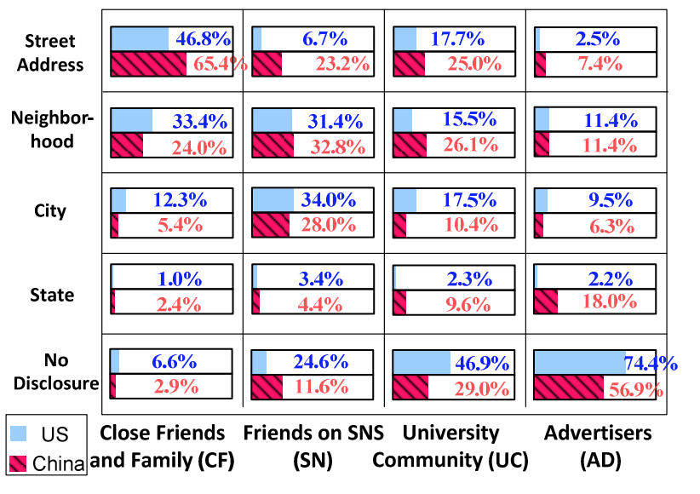
Sharing granularity
In general, Chinese participants tended to share location with higher resolution than their US counterparts.

Slide 28
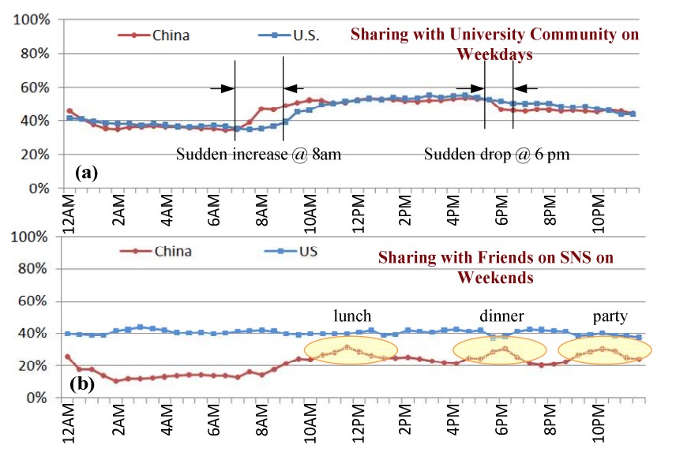
Sharing preferences breakdown by time
On weekends among Chinese participants, we observed three peaks of sharing which could correspond to activities such as lunch, dinner and party.

Slide 29
Final population: Amazon MTurkers!
Study design
– n=775, US participants (non-AMT) vs n=182, US AMT
– US AMT (n=182) vs India AMT (n=128)
Survey:
how you manage personal info online;
E.g., Is any of the following information about you available on the Internet for others to see?
online privacy and anonymity attitudes/prefs
E.g., Do you think that people should have the ability to use the Internet completely anonymously for certain kinds of online activities?
Kang et al. Privacy Attitudes of Mechanical Turk Workers and the U.S. Public. Symposium on Usable Privacy and Security (SOUPS), pages 37–49, 2014

Slide 30
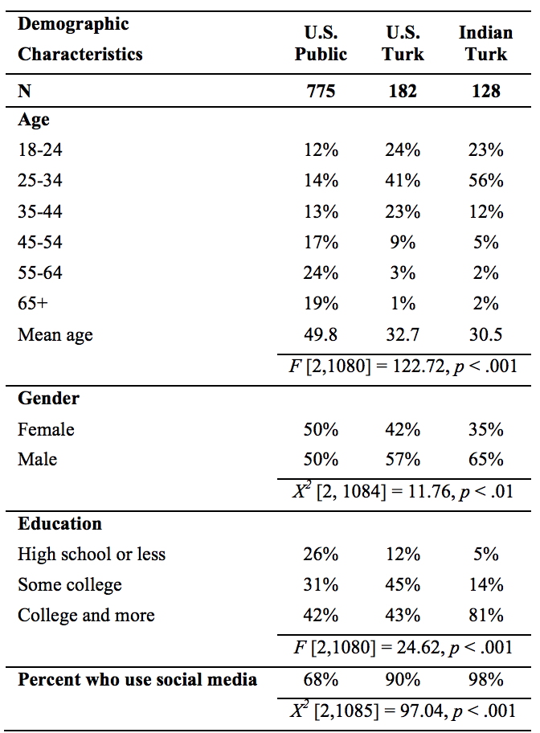
Demographics
mTurk users are younger in general
US public and US mTurk users have similar education background
mTurk users are more exposed to SNS

Slide 31
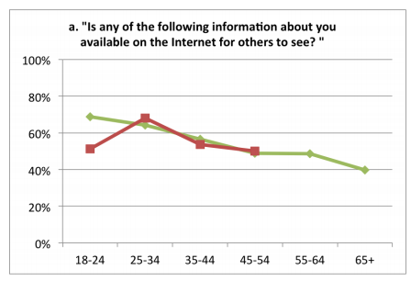
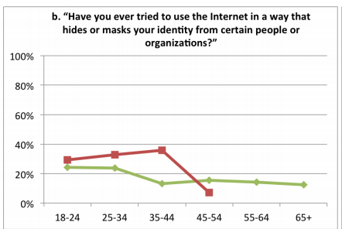
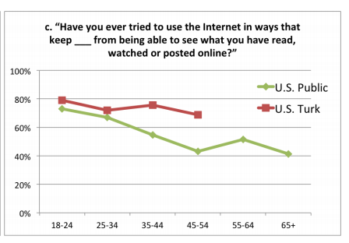
Personal Information: US Public vs mTurk
US mTurk users have tried restricting their personal data more than US public

Slide 32
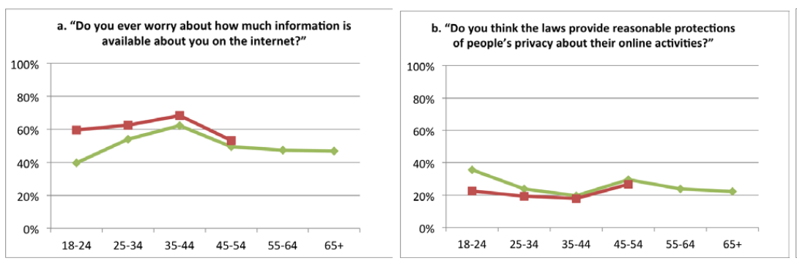
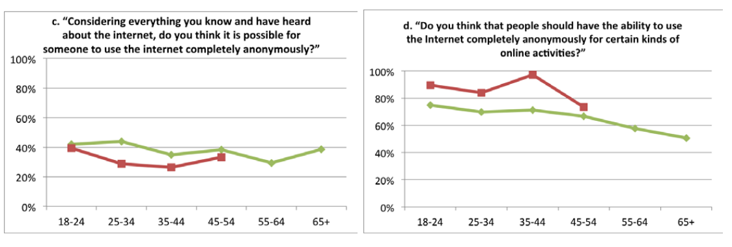
Privacy Preferences: US Public vs mTurk
US mTurk users are more privacy conscious than US public

Slide 33
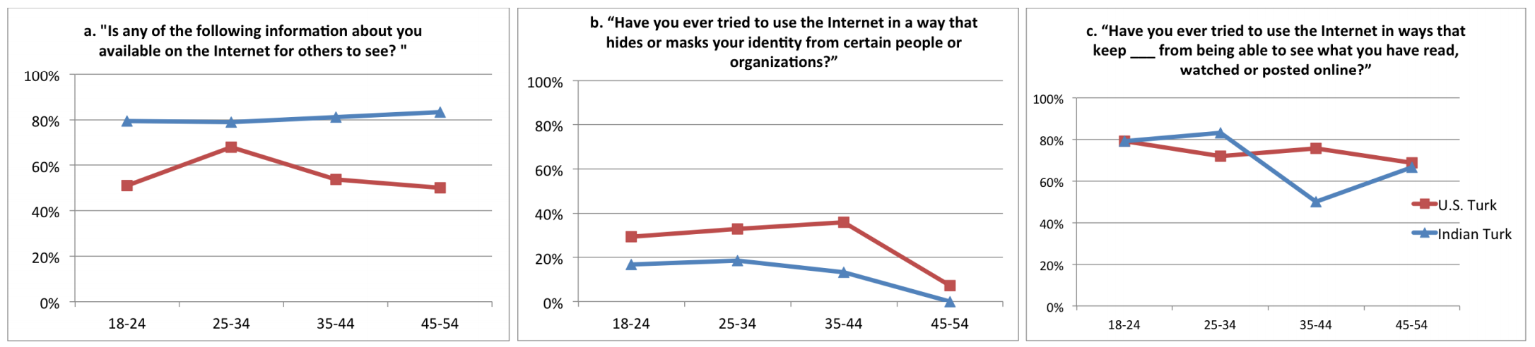
Personal Information: US vs India mTurk
Indian mTurkers were less concerned with their personal information being publicly available.

Slide 34
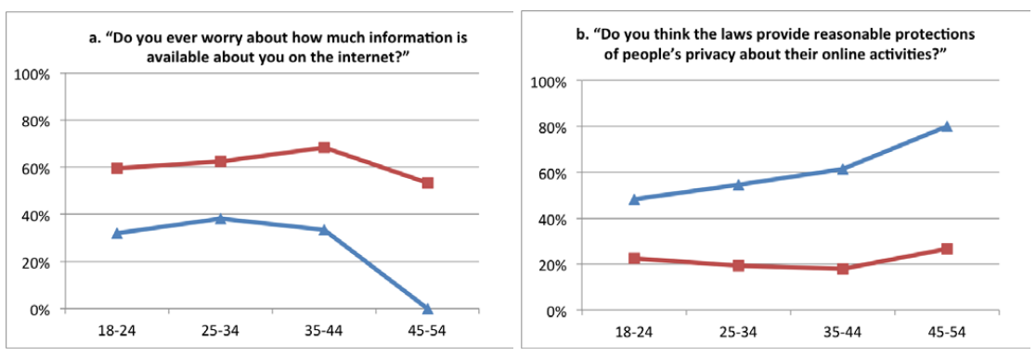
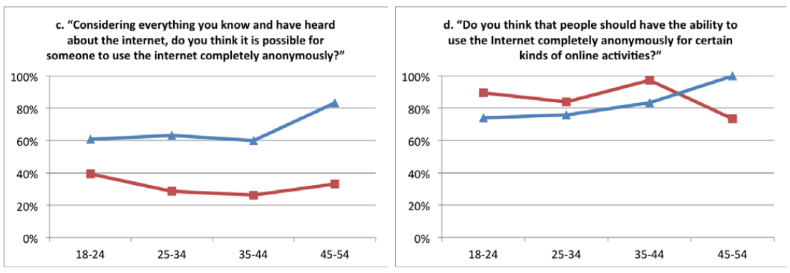
Privacy Preferences: US vs India mTurk
Indian mTurk users are less privacy conscious

Slide 35
General implications
mTurk workers in general are more tech savvy than the general public
Should take the survey results with a grain of salt
If possible provide results for general population (smaller size) to provide some form of comparison.

Slide 36
General Privacy Attitude Towards IoT

Slide 37
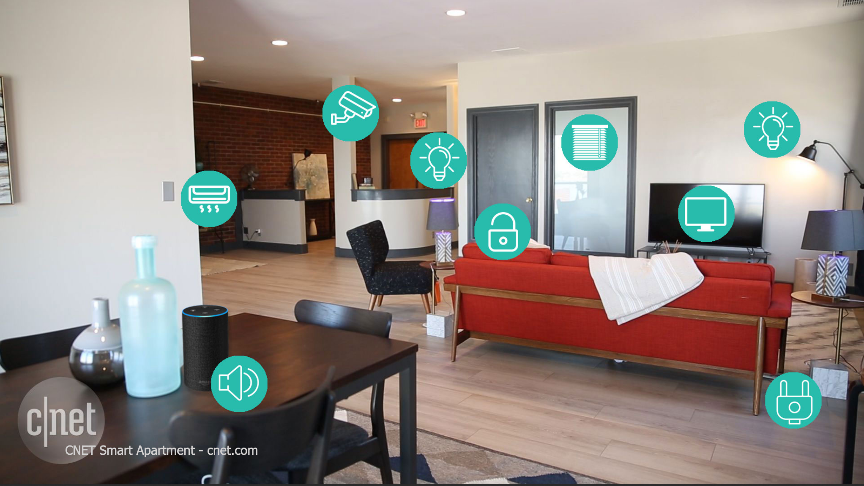
Privacy concerns in smart homes
Lights
Speakers
TVs
Door locks
Power plugs
Cameras
Coffee makers
Ovens
Fridges
Thermostat
Air quality checker
Motion detectors

Slide 38
What factors influence purchases?
Do people think about security and privacy before purchasing IoT devices for their home?
Exploring How Privacy and Security Factor into IoT Device Purchase Behavior
Pardis Emami-Naeini, Yuvraj Agarwal, Lorrie Faith Cranor, and Henry Dixon
User Perceptions of Smart Home IoT Privacy
Serena Zheng, Noah Apthorpe, Marshini Chetty, Nick Feamster

Slide 39
First study: Purchasing factors
Semi-structured interviews asking participants to come to the lab
Recruited 24 participants who have purchased an IoT device for themselves
Pre-screening process: asked questions about the device they bought
Pre-purchase behavior related questions:
what IoT devices they have purchased
how long they have owned them
why they purchased them
ever considered buying an IoT device and ended up not buying it, and the reasons for that decision.
whether they would purchased the device online or in a store, and the factors they considered before making the purchase
Post-purchase behavior related questions :
post-purchase concerns and how they managed them

Slide 40
Purchasing factors
How important it is know about the privacy and security of IoT device(s)
how much more they would be willing to pay to purchase an IoT device that provided privacy and security information as compared to one that did not.
Provided cards for brand, price, privacy, and security
asked them to order them in terms of decision priority
brand
price
privacy
security

Slide 41
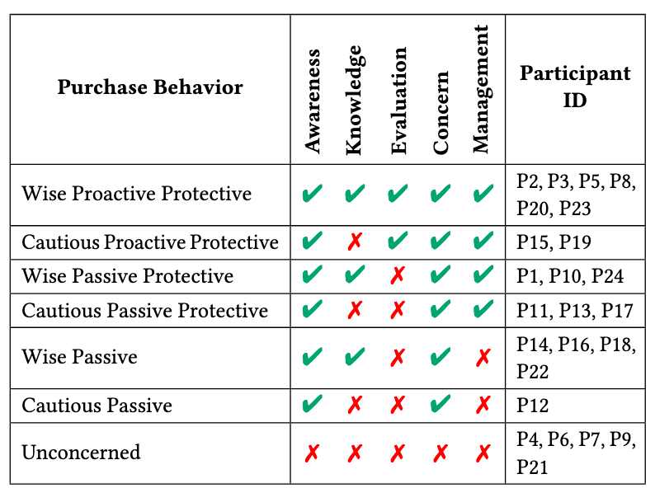
Categorizing user behavior
Pre- and post-purchase conscious behavior → Proactive protective
Not taking security and privacy into consideration → passive
No concerns at all → unconcerned
So what fraction of the users considered security and privacy?

Slide 42
Some are willing to pay more for privacy
Interviewees were most interested in knowing about the purpose of data collection and privacy choices.
Almost all interviewees said they were willing to pay a premium of 10%-30% of the base price of the device.
Reasons for their willingness to pay a premium included assurance that security and privacy would be protected and peace of mind
Those who were reluctant to pay more for privacy and security information often mentioned lack of trust in the device company providing the information.
P12 said: “I wouldn’t necessarily believe it because like with the Facebook thing, regardless of what they say, they’re gonna have all that information.”

Slide 43
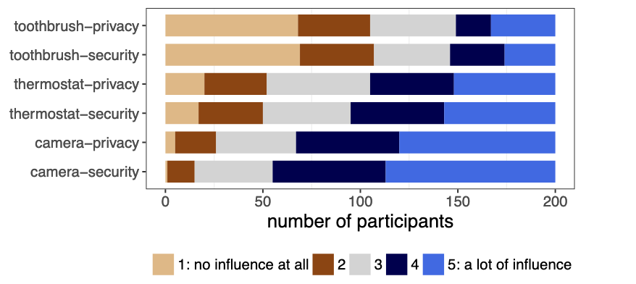
Privacy concerns in smart homes
200 MTurk study
Security and privacy mattered more for which device?
Device type influence decision

Slide 44
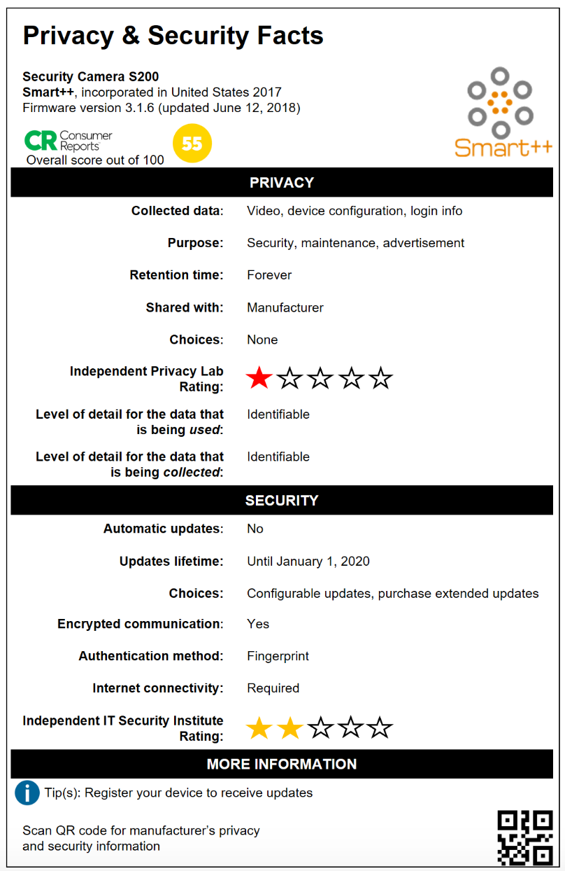
Privacy labels for IoT products
Designed labels for IoT devices
three different variations of a label: more privacy-aware (e.g., data deleted account deletion), least privacy-aware (data stored indefinitely) and in the middle
What is most useful info here?
Appreciated the inclusion of independent ratings and privacy choices.

Slide 45
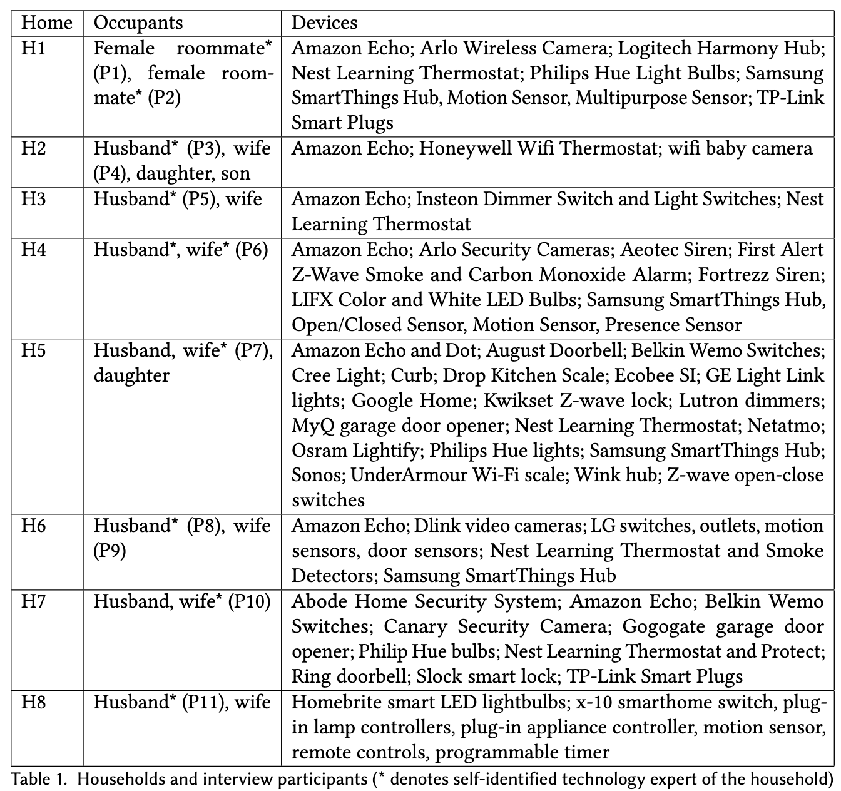
Second study: Household owners
Interview conducted with eleven owners of smart home devices
The majority of the households were from the Seattle metro area
Participants were fairly affluent, technically skilled, and highly interested in new technology, fitting the profile of an “early adopter”

Slide 46
Privacy concerns related questions
How do your devices work?
What data do your devices collect?
How would you feel if someone else knew about this data?
Do you have any privacy concerns about these devices?
Would you be willing to take any steps to protect your privacy?

Slide 47
Privacy perceptions of users
Convenience and Connectedness are Priorities
Participants highly valued how smart home devices made their lives easier, more connected, and more convenient.
Opinions about Data Access Depend on Perceived Benefit from External Entities
device manufacturers, advertisers, ISPs, and the government
Mostly fine with manufacturer
6 out of 11 were fine with advertisers
ISPs and government had negative views
Trust in brand reputation, especially influenced participants’ selection of IoT devices for their homes.
Skepticism of Non-Audio/Video Device Privacy Risks
I’d be happier if someone hacked a plug than the camera pointed in the living room (p1).

Slide 48
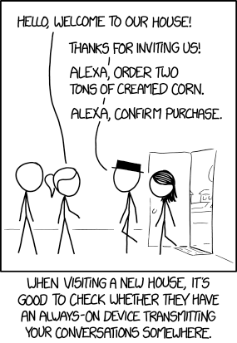
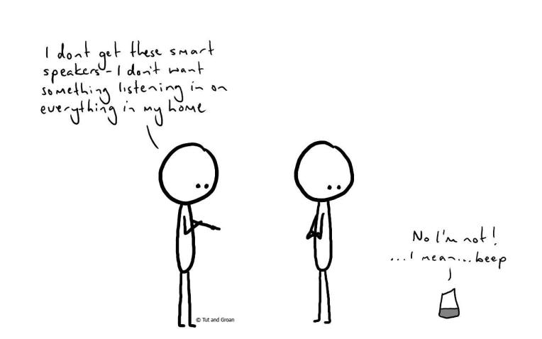
Privacy concerns with smart speakers
43 Million Americans Own a Smart Speaker

Slide 49
Privacy concerns with smart speakers
What factors affect the (non-)adoption of smart speakers?
What are individuals’ privacy perceptions and concerns regarding smart speakers?
How do those privacy concerns affect their behavior around and with smart speakers?
A diary study followed by semi-structured interviews with
17 smart speaker users
17 non-users
J. Lau, B. Zimmerman, and F. Schaub, “Alexa, are you listening?: Privacy perceptions, concerns and privacy-seeking behaviors with smart speakers,” Proc. ACM Hum.-Comput. Interact., vol. 2, no. CSCW, pp. 102:1–102:31, Nov. 2018.

Slide 50
Factors for adoption
Convenience
music playback (14),checking the weather (13), probing smart speaker capabilities (11), controlling other devices (8),asking knowledge questions (6), setting timers (6), checking the time (4), checking the news (3),setting alarms (3), setting reminders (3), checking their calendar (2), purchasing items online (2),playing games (1), and listening to the radio (1)
Identity as an early adopter
Eleven users either explicitly said they liked to be an ‘early adopter’ or implicitly described themselves as such
Contributing factors for smart speaker use
considerations of price (6), family and housemates (5), technology ecosystem and integrations (5), and device aesthetics (1)

Slide 51
Factors for non-adoption
Perceived lack of utility
While many non-users discussed the potential convenience of smart speakers, they did not feel the devices’ usefulness justified their cost, yet
Privacy and security concerns
As expected, privacy emerged as a major deterring factor for smart speaker adoption (8/17)
Summary
privacy-concerned non-users were uncomfortable with an ‘always listening’ device in their home
utility-oriented users felt safe and trusted the companies because of their scale, resources, prior positive experiences with them

Slide 52
Lessons
Privacy concerns and attitude vary based on
culture
geolocation
past experience / exposure
Developers should keep in the mind the intended audience while developing privacy protocols

Slide 53
Logistics
Homework #5 due Nov 06, 2020 by 11:59pm
Project final report due Nov 16 @ 11:59pm
Make sure you make sufficient progress

